Slide 2
components used
1.XBEE MODULE
2.SOLAR PANEL
3.DHT 11 SENSOR
3.SMOKE SENSOR
4.ARDUINO UNO
5.BUZZER

Slide 3
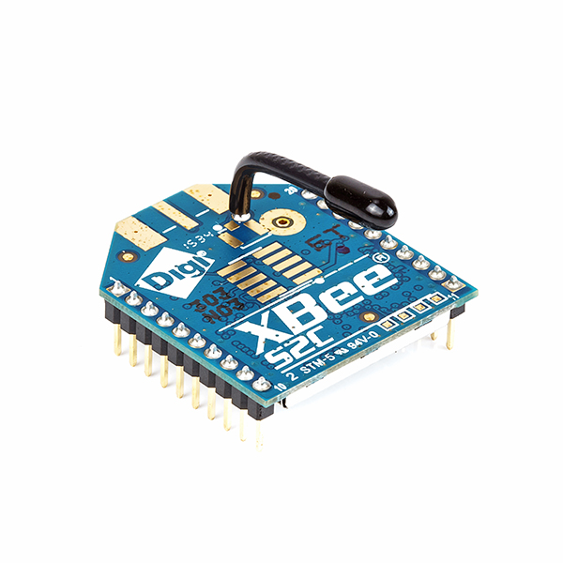
XBEE MODULE
Zigbee is an IEEE 802.15.4-based specification for a suite of high-level communication protocols used to create personal area networks with small, low-power digital radios, such as for home automation, medical device data collection, and other low-power low-bandwidth needs, designed for small scale projects which need wireless connection.
Zigbee is a low-cost, low-power, wireless mesh network standard targeted at battery-powered devices in wireless control and monitoring applications. Zigbee delivers low-latency communication. Zigbee chips are typically integrated with radios and with microcontrollers. Zigbee operates in the industrial, scientific and medical (ISM) radio bands: 2.4 GHz in most jurisdictions worldwide; though some devices also use 784 MHz in China, 868 MHz in Europe and 915 MHz in the USA and Australia, however even those regions and countries still use 2.4 GHz for most commercial Zigbee devices for home use. Data rates vary from 20 kb/s (868 MHz band) to 250 kb/s (2.4 GHz band).
Zigbee devices are of three kinds:
Zigbee Coordinator (ZC): The most capable device, the Coordinator forms the root of the network tree and might bridge to other networks. There is precisely one Zigbee Coordinator in each network since it is the device that started the network originally (the Zigbee LightLink specification also allows operation without a Zigbee Coordinator, making it more usable for off-the-shelf home products). It stores information about the network, including acting as the Trust Center & repository for security keys.
Zigbee Router (ZR): As well as running an application function, a Router can act as an intermediate router, passing on data from other devices.
Zigbee End Device (ZED): Contains just enough functionality to talk to the parent node (either the Coordinator or a Router); it cannot relay data from other devices. This relationship allows the node to be asleep a significant amount of the time thereby giving long battery life. A ZED requires the least amount of memory, and, therefore, can be less expensive to manufacture than a ZR or ZC.

Slide 4
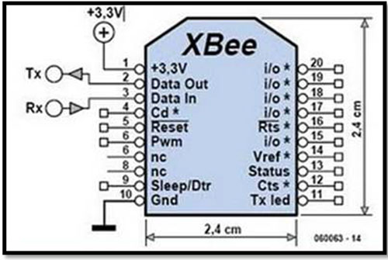
XBEE PIN CONGIURATION AND PROS
Low to medium data rates
Lots of nodes (up to 65,565)
Easy addition or removal of nodes from network
Robust mesh network that doesn't fall over if one node fails
Very low power, battery operated equipment
Long range

Slide 5
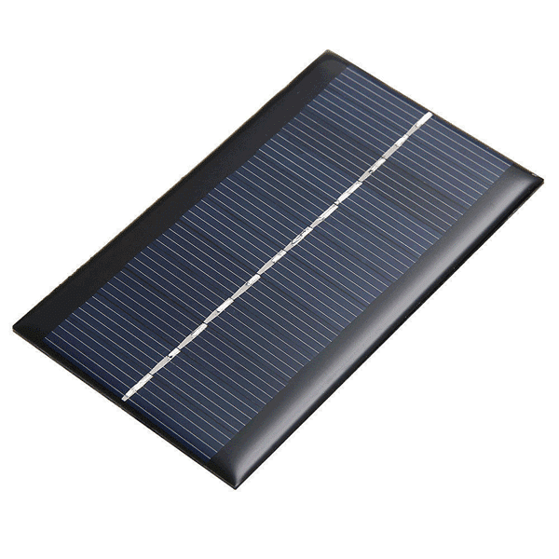
SOLAR PANEL
THE SUCCESS OF ANY PROJECT GOES IN HAND WITH THE COST EFFECTIVENESS.AS ENERGY IS REQUIRED FOR OPERATION OF XBEE ARDUINO DETECTORS AND BUZZER,WE TRIED TO USE SOLAR ENERGY FOR THAT.SINCE ARDUINO WORKS FOR 5V IT CAN EASILY BE PROVIDED BY USING SOLAR ENERGY.
THIS MAKES THE SYSTEM SELF RELIABLE AND AND ALSO SAVES A MAJOR CAPITAL.
WE HAVE USED 6V 1W SOLAR PANEL FOR THE NECESSARY ENERGY REQUIREMENT.

Slide 6
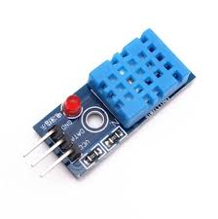
DHT11 TEMPERATURE SENSOR
DHT11 Temperature & Humidity Sensor features a temperature & humidity sensor complex with a calibrated digital signal output. By using the exclusive digital-signal-acquisition technique and temperature & humidity sensing technology, it ensures high reliability and excellent long-term stability. This sensor includes a resistive-type humidity measurement component and an NTC temperature measurement component, and connects to a highperformance 8-bit microcontroller, offering excellent quality, fast response, anti-interference
ability and cost-effectiveness.
DHT11 Specifications:
Operating Voltage: 3.5V to 5.5V
Operating current: 0.3mA (measuring) 60uA (standby)
Output: Serial data
Temperature Range: 0°C to 50°C
Humidity Range: 20% to 90%
Resolution: Temperature and Humidity both are 16-bit
Accuracy: ±1°C and ±1%

Slide 7
solution
Forest fire has emerged as a global concern over past few years.due to increase in earth mean temperature and Wind heat ,it has become a need of hour to effectively control the forest fire which greatly affects the the forest system including wildlife and biodiversity loss.
Taking in consideration the basic demand of a forest fire managment system ,it should be in real time and a self reliable.By real time we means to say that parameters like temperature , smoke (co) presence should be detected ,read and stored at every instant.The data being measured should be transmitted to control system wirelessely with great speed and low power input.
This has made us to implement Xbee a new innovation in field of wirless communication.XBEE needs less power and supports mesh topolgy,thus helps in creating a robust network .We have used XBEE 24c family to establish a wirless communication.we have used two zigbee,one in forest side while other in control room side.forest side zigbee senses various parameters and send it to control room.control room has a system which monitors the data being received and takes the suitable action according to it.here we have used buzzer which will get activated depending on the control action.
Sometime their may be sudden rise in temperature,so to avoid the conflict of data,we have also added a smoke sensor which will detect the presence of smoke i.e. indication of forest fie.this makes the system more intelligent
We have also tried to make it self reliable by implementing solar panels to meet the energy requirements solar panels.
the energy required by the system in forest side is meet up with the solar energy,thus making the system self reliable.
Another element that we have added is the real time data monitoring .we are recording the value of temperature at every finite time instant.
Further advancement that we can propose is addition of a gsm module ,which will notify other sectors like hospitals etc in case of mishappening.

Slide 8
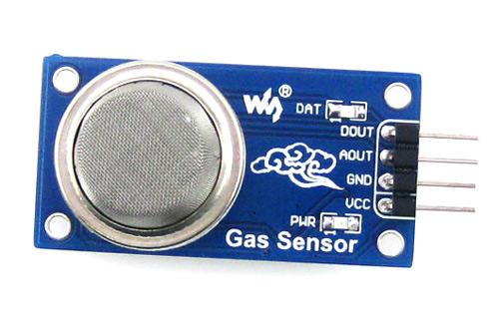
MQ2 SMOKE DETECTOR
The MQ-2 is a flammable gas and smoke sensor detects the concentrations of combustible gas in the air and outputs its reading as an analog voltage.The sensor can measure concentrations of flammable gas of 300 to 10,000 ppm.The MQ-2 gas sensor is sensitive to LPG, i-butane, propane, methane, alcohol, Hydrogen and smoke.They are used in gas leakage detecting equipments in family and industry and in portable gas detector.
Specification:
Supply Voltage 5V
Sensitive to H2, LPG, CH4, CO, Alcohol, Smoke or Propane
Analog and Digital Output
Digital Out is High or Low based on a adjustable preset threshold.

